Slide 1
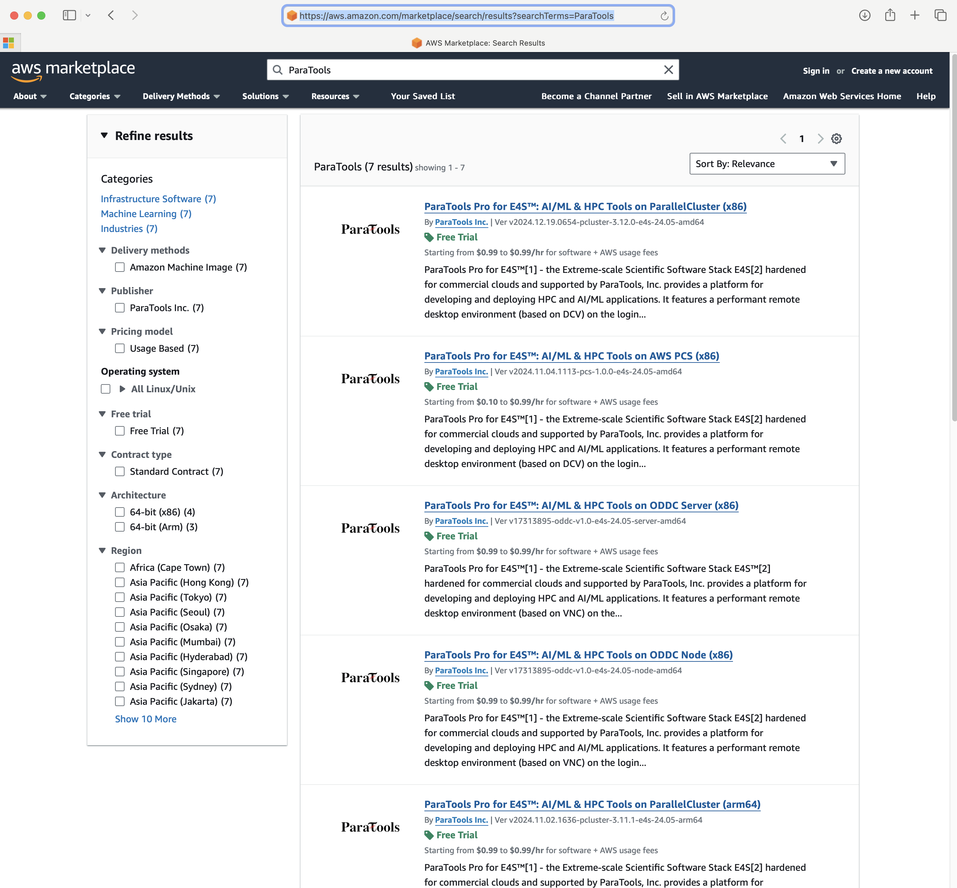
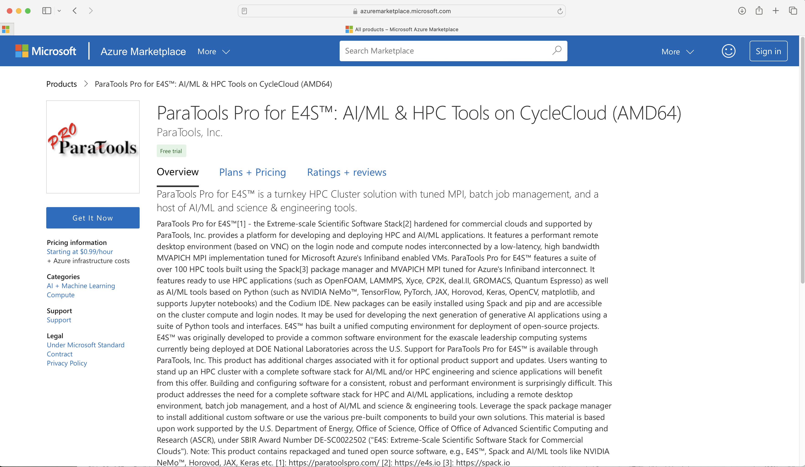
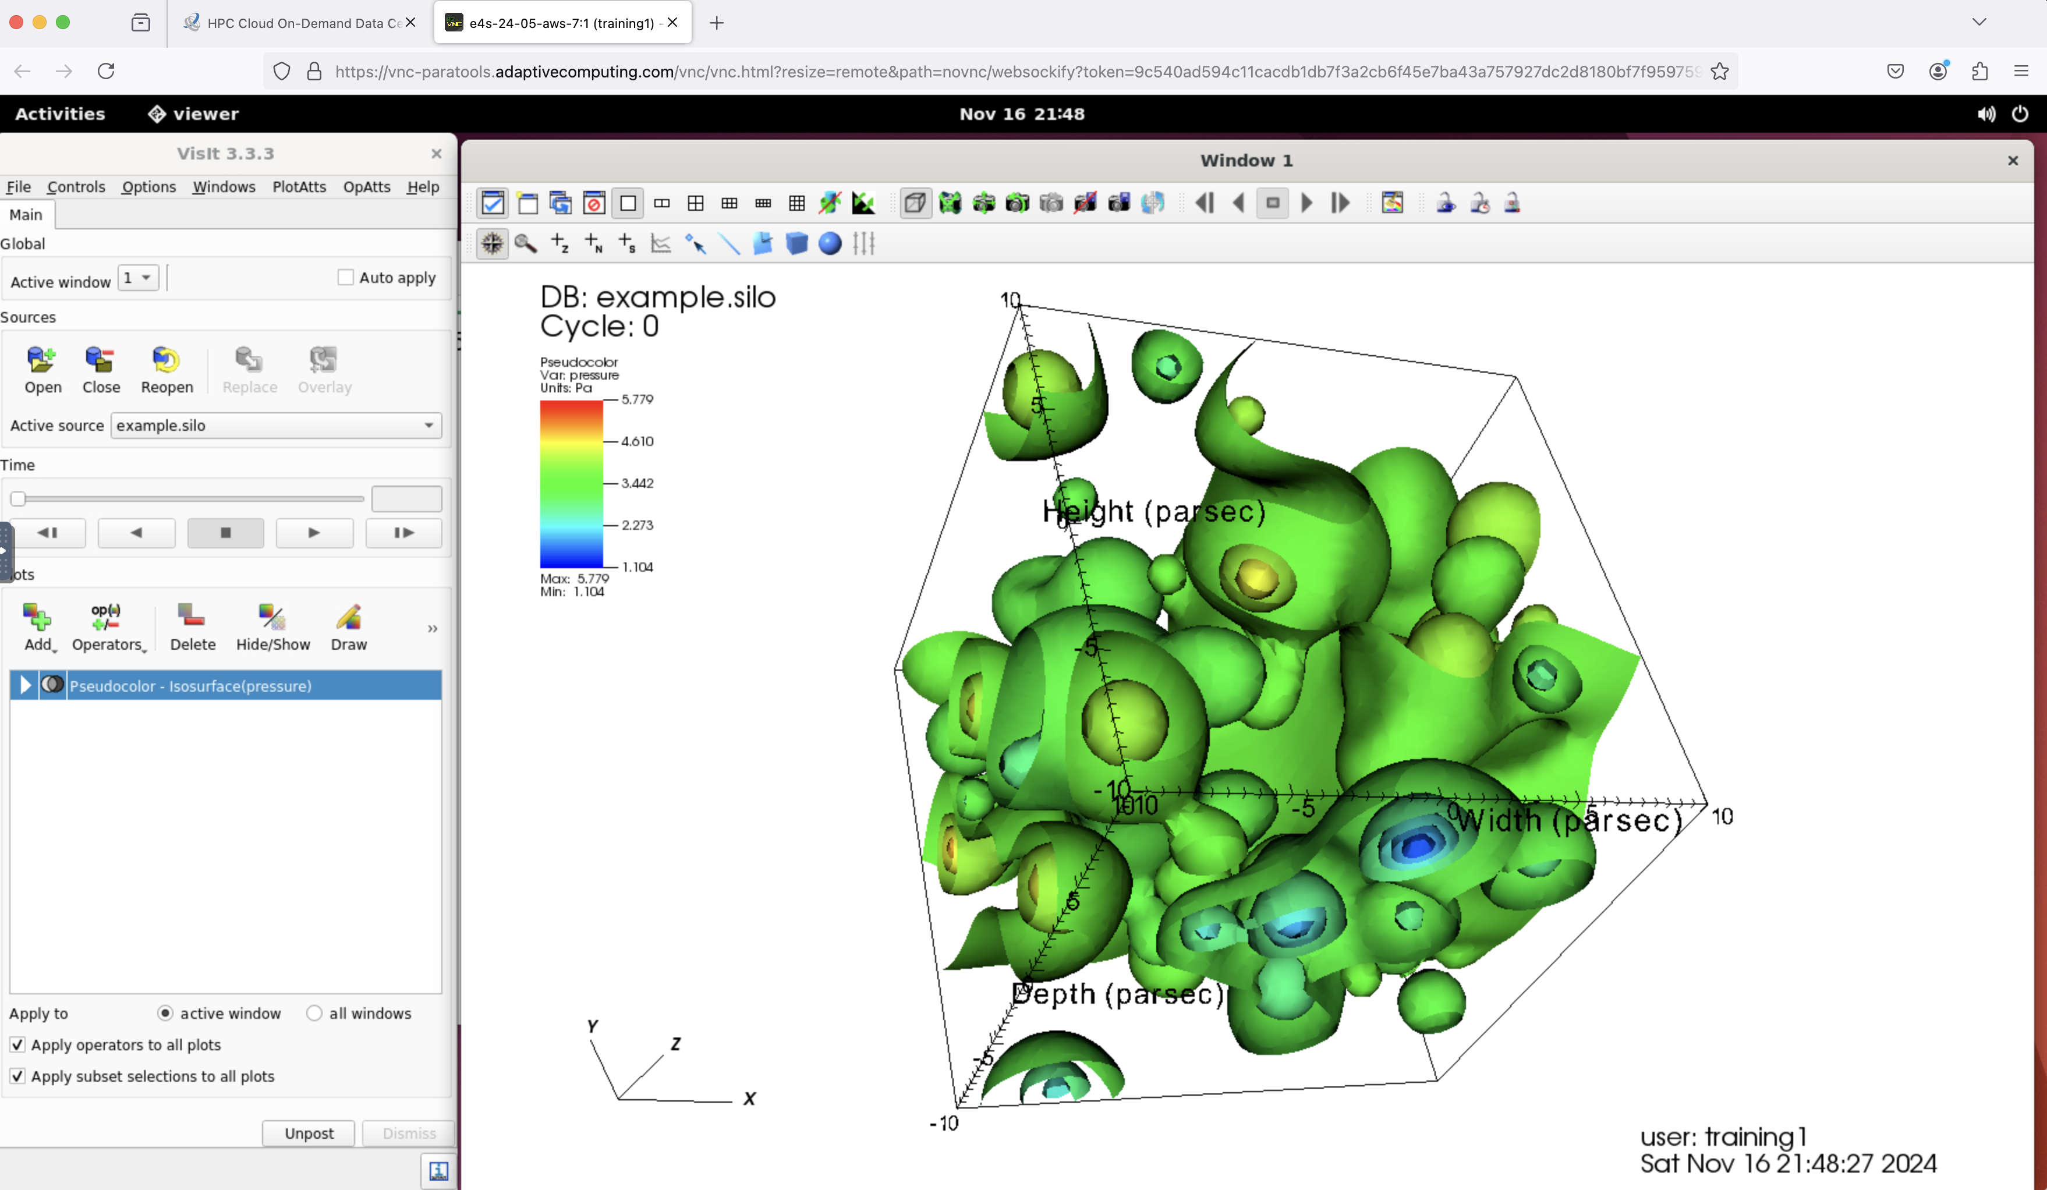
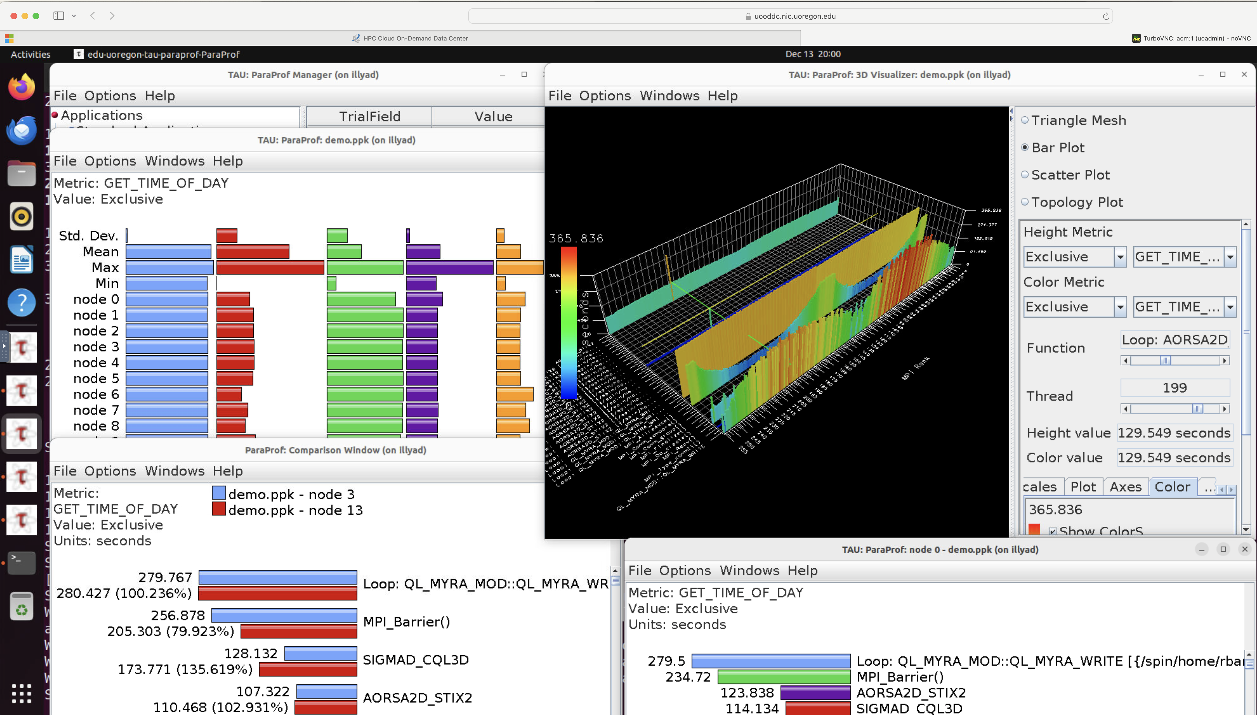
ParaTools Pro for E4STM
A development environment for HPC-AI: Ecosystem for Science on Commercial Clouds
Developed under DOE SBIR Phase II award no. DE-SC0022502, ParaTools Pro for E4STM is an HPC-AI cloud image.
E4S: Extreme-Scale Scientific Software Stack for commercial clouds is an effort to provide open-source software packages for developing, deploying and running scientific HPC and AI applications on commercial cloud platforms.
E4S provides a curated, Spack-based software distribution of 120+ HPC applications (OpenFOAM, Gromacs, Nek5000, LAMMPS), Tools (TAU, MVAPICH, HPCToolkit, PAPI, PETSc, Trilinos, VisIt, ParaView), EDA (e.g., Xyce), and AI/ML packages (NVIDIA NeMo, TensorFlow, PyTorch, TorchBraid, Scikit-Learn, Pandas, JAX, Horovod, LBANN with GPU support).
Includes MVAPICH MPI optimized for high-performance cloud networks, including EFA on Amazon and IPU on Google Cloud.
Support for commercial clouds: Adaptive Computing Inc.’s ODDC with ParaTools Pro for E4STM image for AWS, GCP, Azure.
Available on Amazon AWS, Google Cloud, and Azure Marketplaces and generating revenue. https://paratoolspro.com

